Slide 1
QUIZ TIME
START

Slide 2
WHAT IS THIS PICTURE?
BEAR
COW BOY

Slide 3
NEXT

Slide 4
BACK
NEXT

Slide 5
WHAT IS THIS PICTURE?
DOG
PIG

Slide 6
NEXT

Slide 7
BACK
NEXT

Slide 8
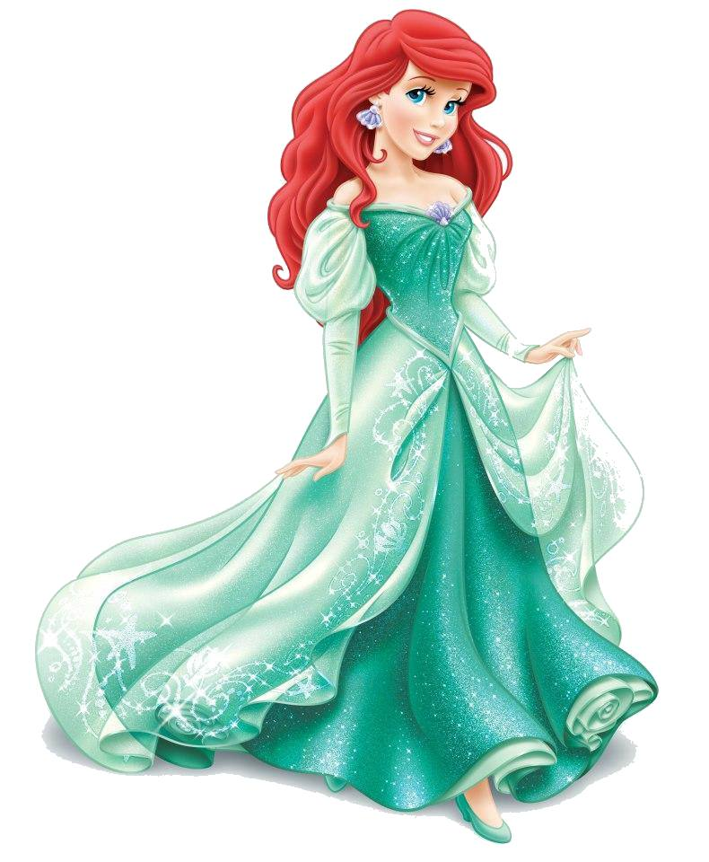
WHAT COLOR IS IT?
GREEN
BLUE

Slide 9
CORRECT
NEXT

Slide 10
TRY AGAIN
BACK
NEXT

Slide 11
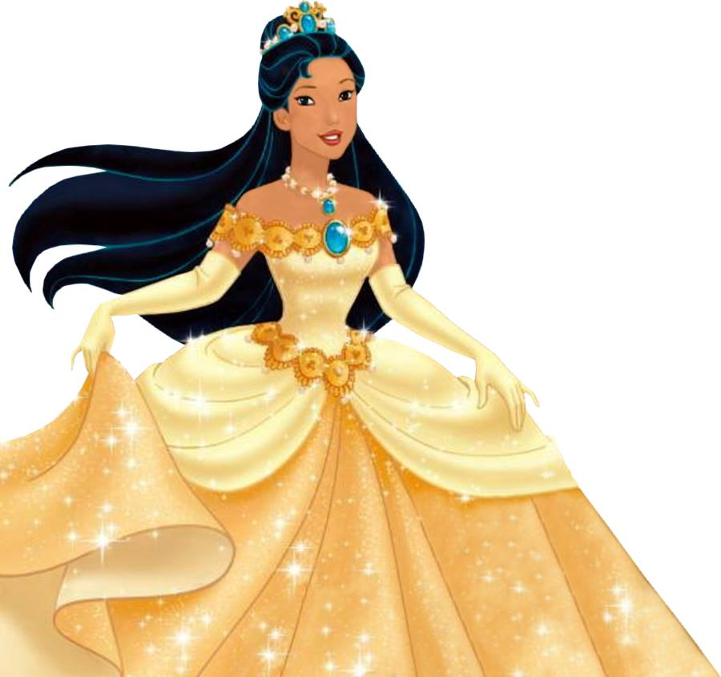
WHAT COLOR IS IT?
PINK
AMBER

Slide 12
CORRECT
NEXT

Slide 13
TRY AGAIN
BACK
NEXT

Slide 14
WHAT ARE THEY FEEL?
HAPPY
ANGRY

Slide 15
NEXT

Slide 16
BACK
NEXT

Slide 17
WHAT ARE THEY FEEL?
ANNOYED
HORRIFIED

Slide 18
NEXT

Slide 19
BACK
NEXT

Slide 20
THE END

